Slide 1
Detecting Exoplanets and recovering Parameters
A short recap of my work in week 5

Slide 2
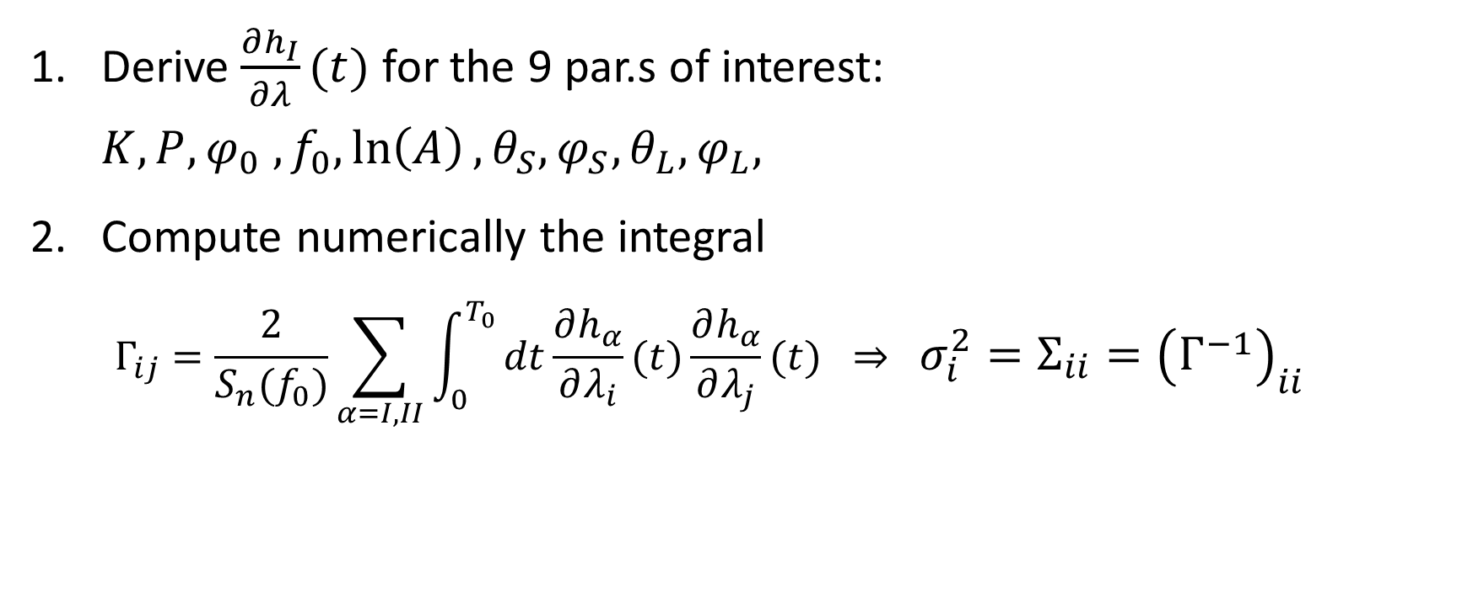
What did Tamanini and Danielski do?
Derive $\frac{∂h_{I}}{∂λ}(t)$ for the 9 par.s of interest: $K,P,φ_{0} ,f_{0},\ln\left(A\right),θ_{S},φ_{S},θ_{L},φ_{L},$
Compute numerically the integral $Γ_{ij}=\frac{2}{S_{n}(f_{0})}\sum_{α=I,II}{\int_{0}^{T_{0}}{dt\frac{∂h_{α}}{∂λ_{i}}(t)\frac{∂h_{α}}{∂λ_{j}}(t)} } ⇒ σ_{i}^{2}=Σ_{ii}={\left(Γ^{−1}\right)}_{ii}$

Slide 3
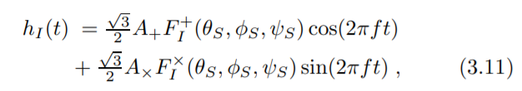
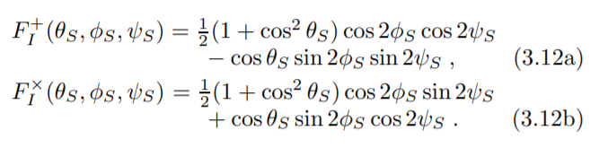
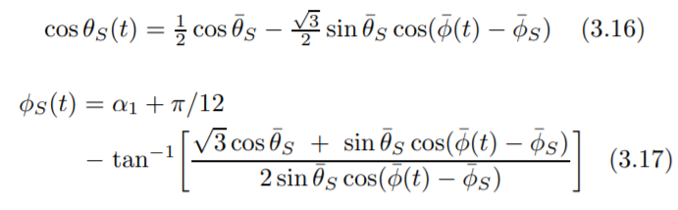
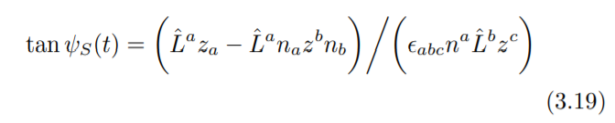
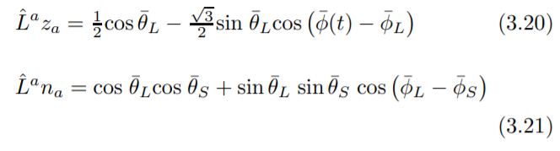
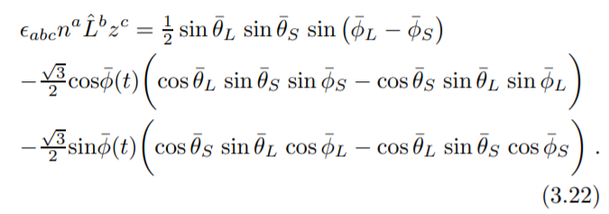
Regarding the position and angular momentum
The position and angular momentum of the binary source influences the strain non-trivially, see [3]:

Slide 4
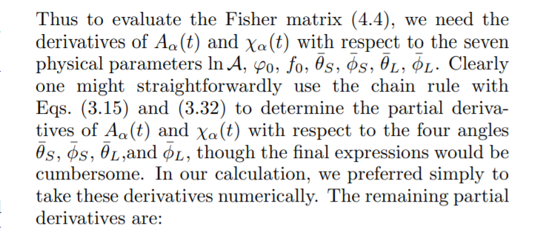
…so we do what Cutler proposes
In our case we initialise a second class instance of our class binary(position + 1e-6) and compare it via (binary(position + 1e-6) – binary(position)) / 1e-6 (same as scipy.misc.derivative)

Slide 5
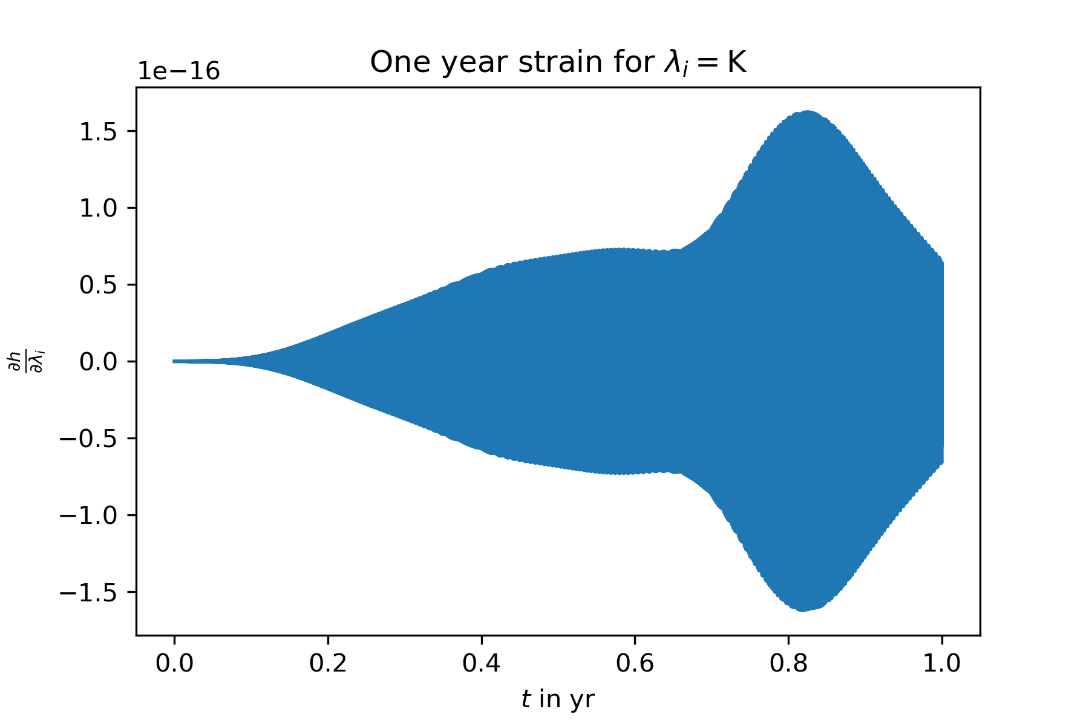
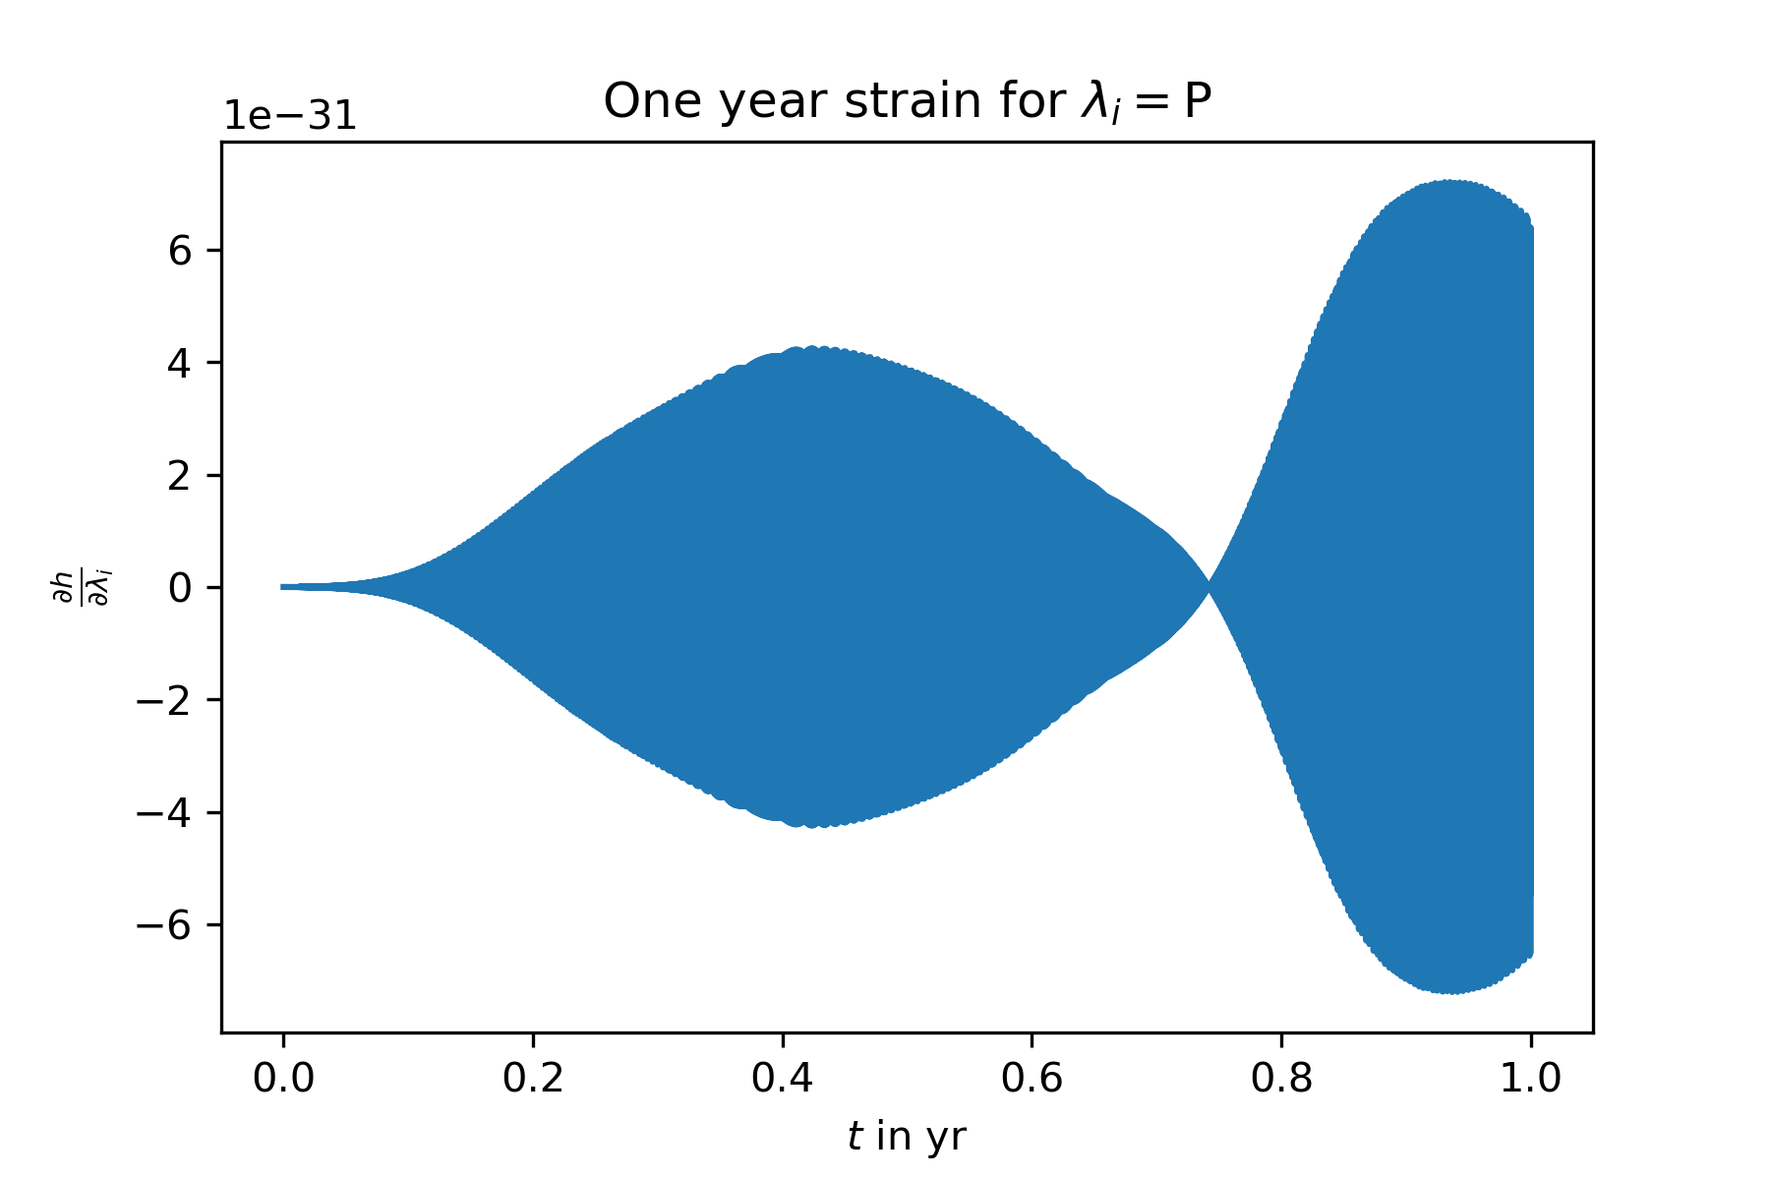
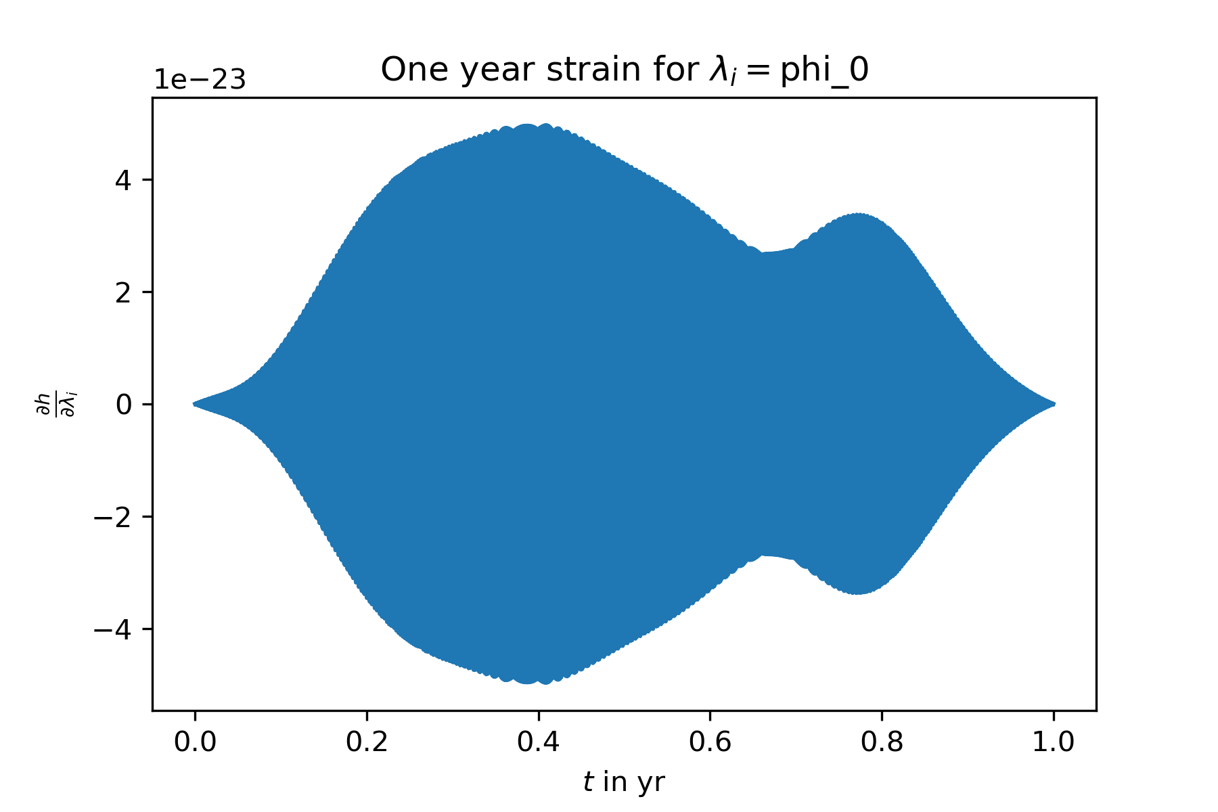
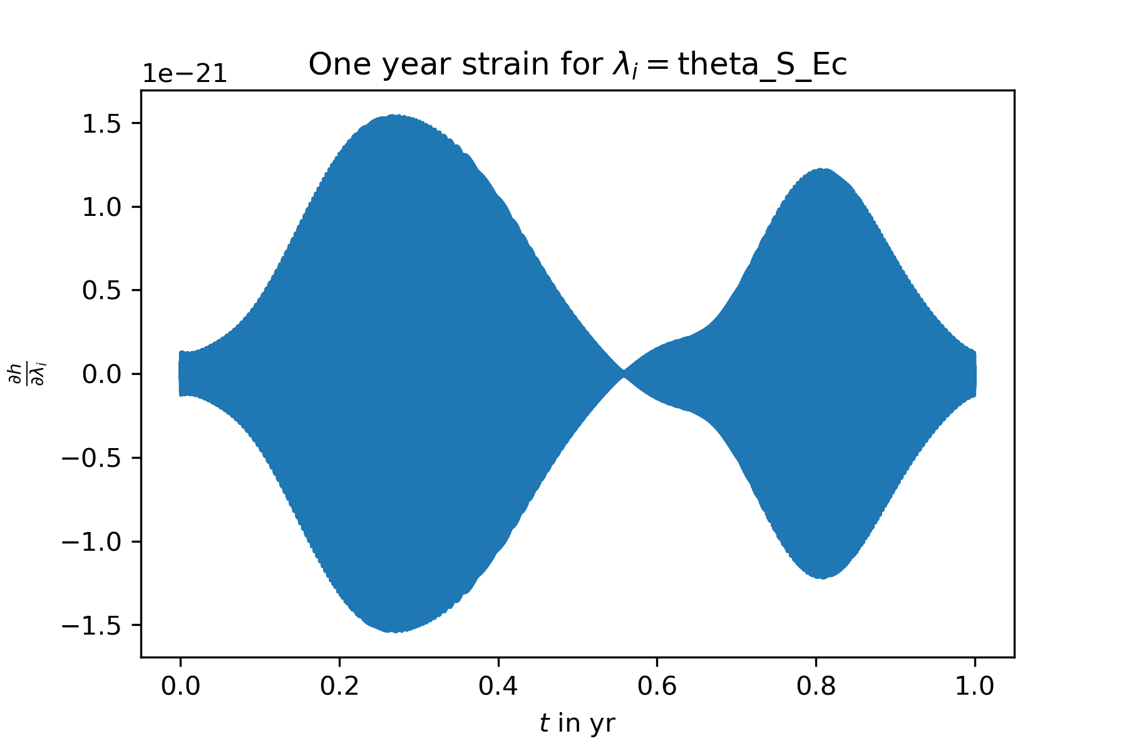
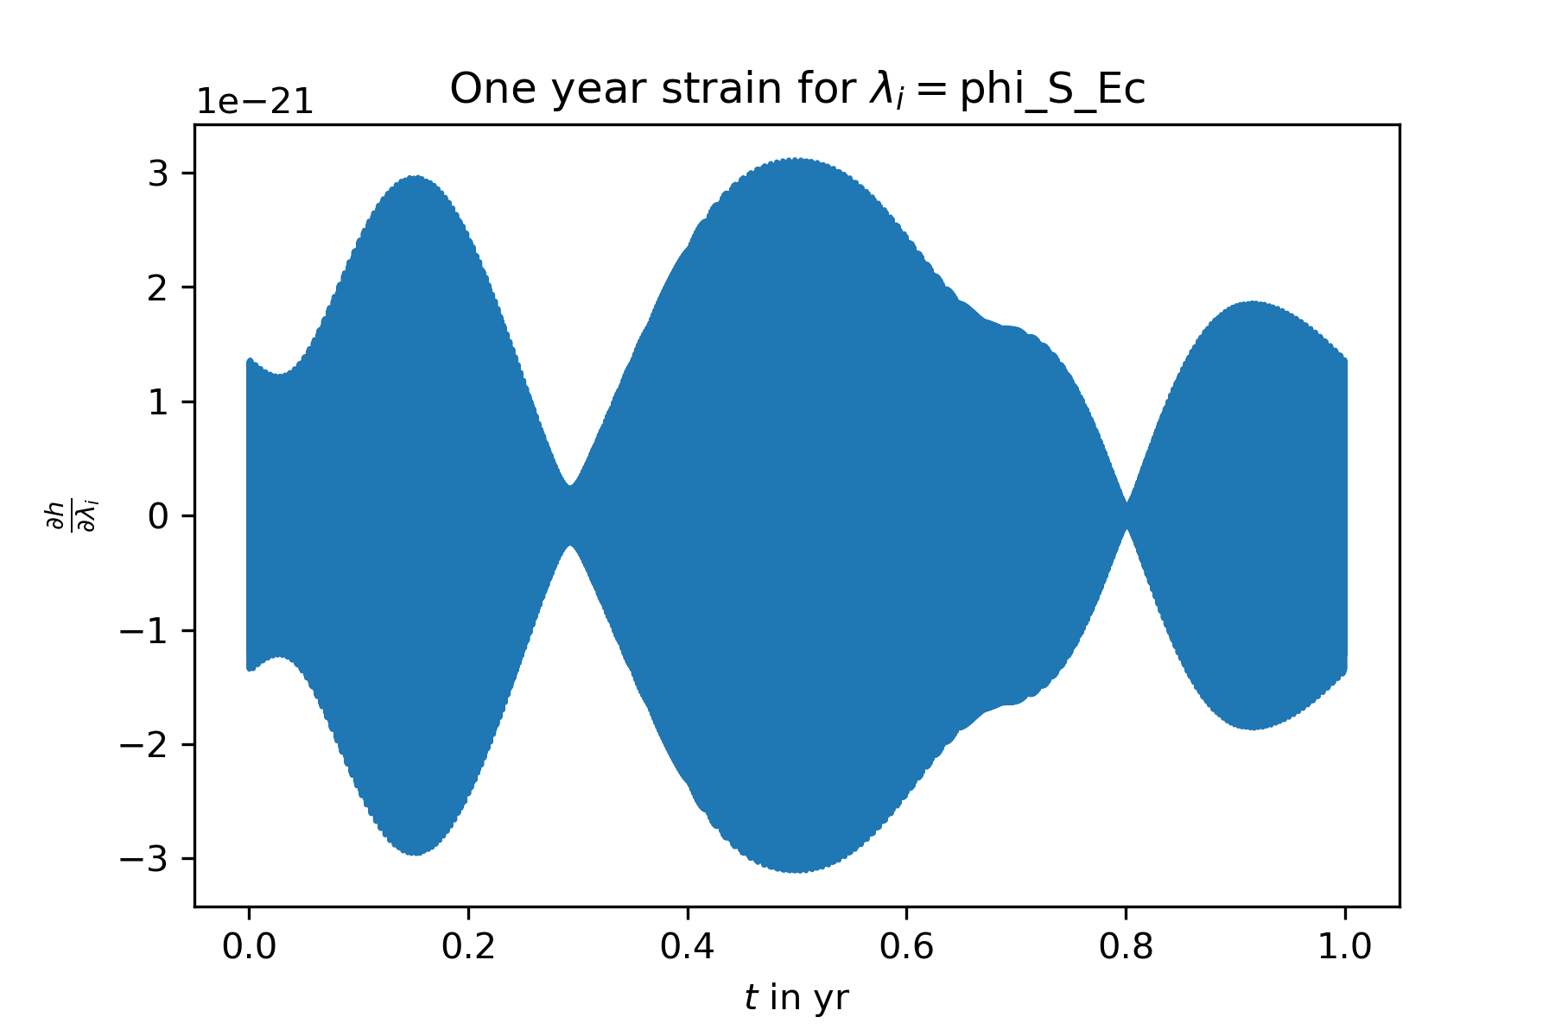
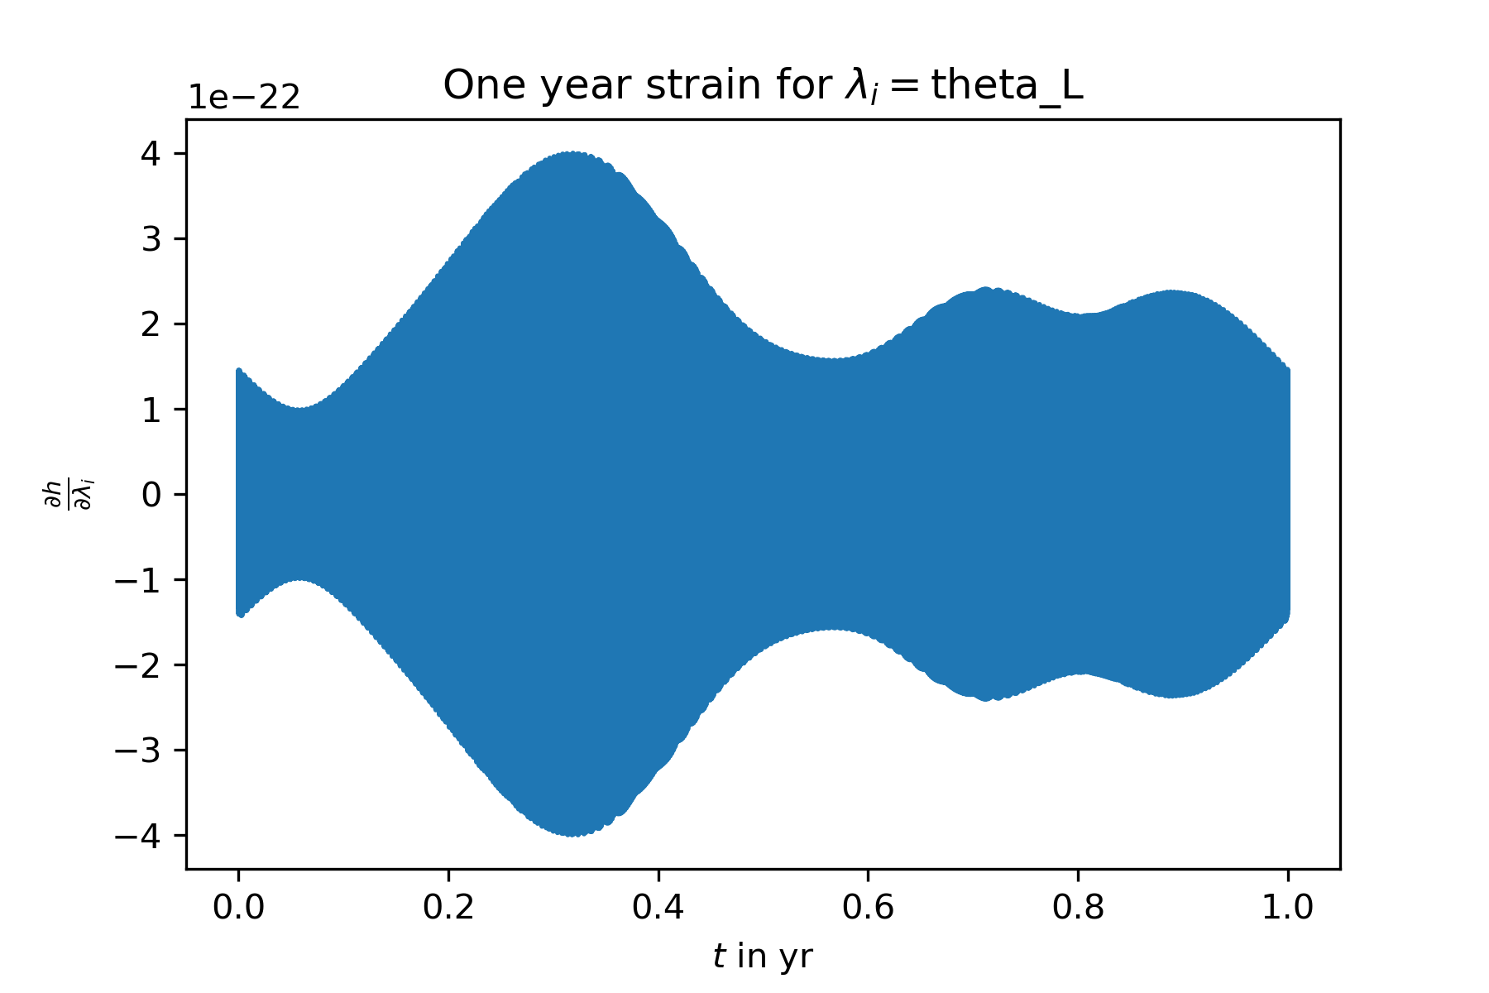
The derivatives $\frac{∂h_{α}}{∂λ_{i}}$ look good, compare the analytic derivatives of the exoplanet par‘s (above) with the numerical derivatives of the position par‘s (below) – same structure: envelope * oscillating function

Slide 6
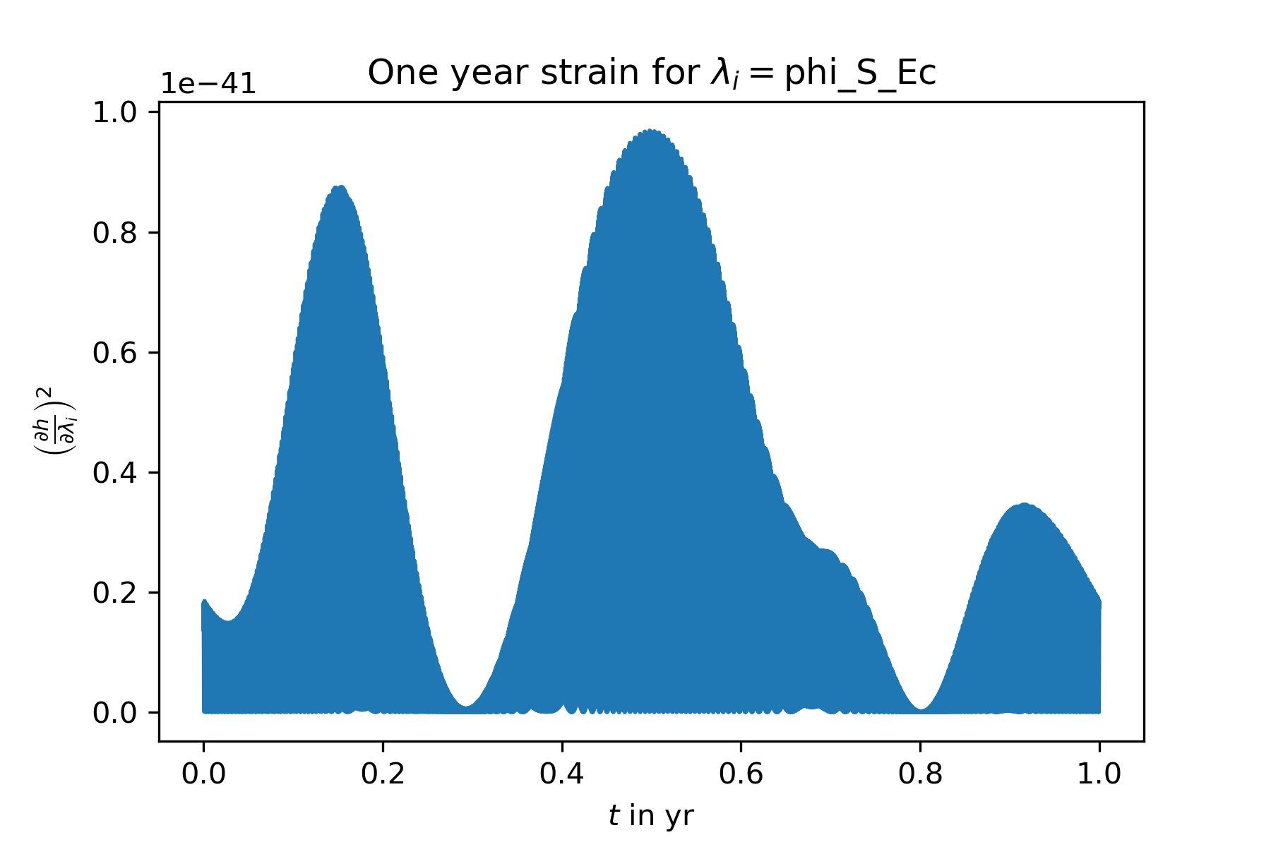
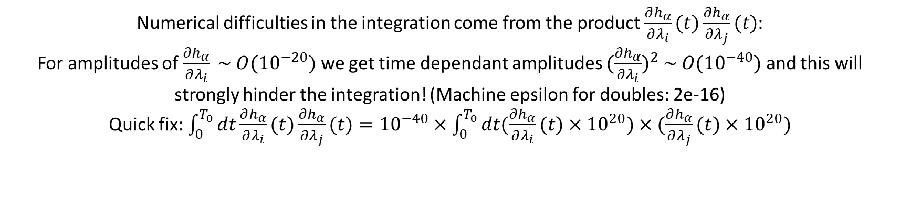
Numerical difficulties in the integration come from the product $\frac{∂h_{α}}{∂λ_{i}}(t)\frac{∂h_{α}}{∂λ_{j}}(t)$:
For amplitudes of $\frac{∂h_{α}}{∂λ_{i}} \sim O({10}^{−20})$ we get time dependant amplitudes ${(\frac{∂h_{α}}{∂λ_{i}})}^{2} \sim O({10}^{−40})$ and this will strongly hinder the integration! (Machine epsilon for doubles: 2e-16)
Quick fix: $\int_{0}^{T_{0}}{dt\frac{∂h_{α}}{∂λ_{i}}(t)\frac{∂h_{α}}{∂λ_{j}}(t)}={10}^{−40}×\int_{0}^{T_{0}}{dt(\frac{∂h_{α}}{∂λ_{i}}(t)×{10}^{20})×(\frac{∂h_{α}}{∂λ_{j}}(t)}×{10}^{20})$

Slide 7
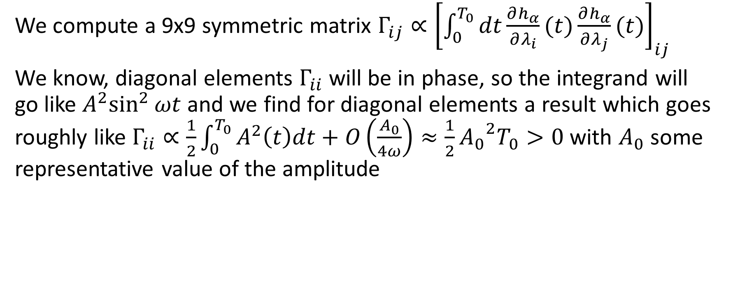
A new problem has approached
We compute a 9x9 symmetric matrix $Γ_{ij}∝{\left[\int_{0}^{T_{0}}{dt\frac{∂h_{α}}{∂λ_{i}}(t)\frac{∂h_{α}}{∂λ_{j}}(t)}\right]}_{ij}$
We know, diagonal elements $Γ_{ii}$ will be in phase, so the integrand will go like ${A^{2}sin}^{2}{ωt}$ and we find for diagonal elements a result which goes roughly like $Γ_{ii}∝\frac{1}{2}\int_{0}^{T_{0}}{A^{2}\left(t\right)dt}+O\left(\frac{A_{0}}{4ω}\right)≈\frac{1}{2}{A_{0}}^{2}T_{0}>0$ with $A_{0}$ some representative value of the amplitude

Slide 8
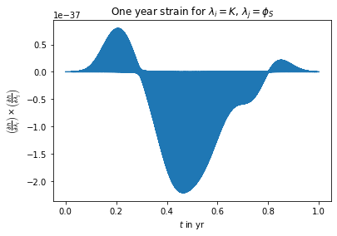
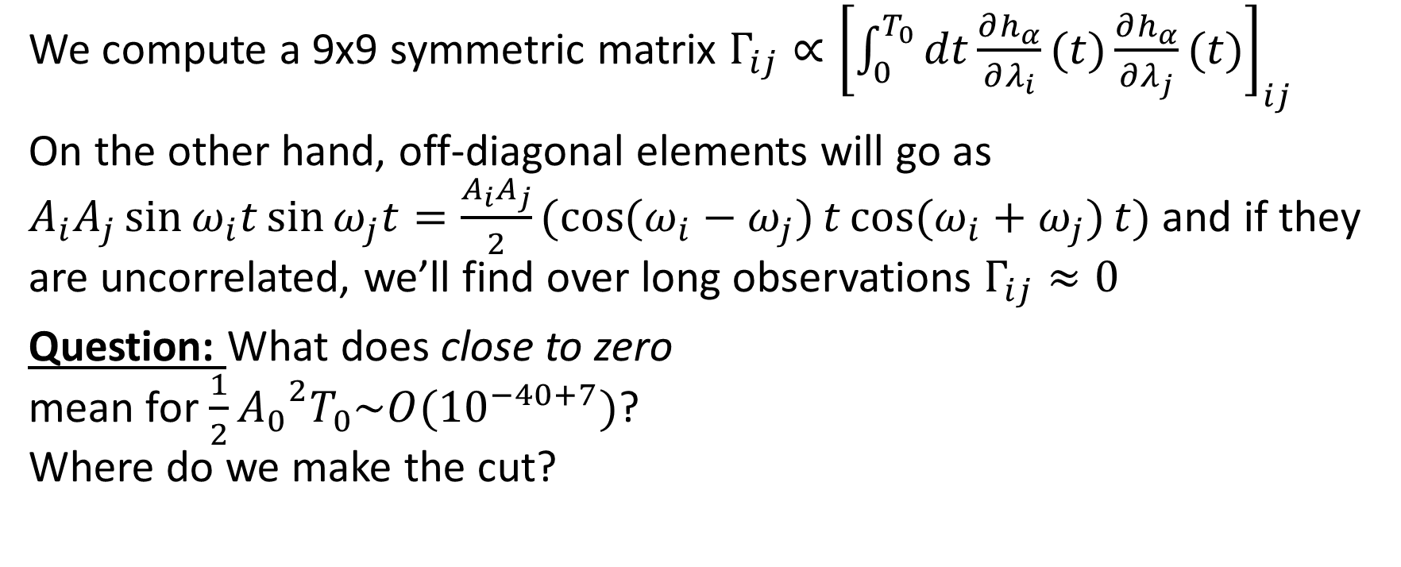
A new problem has approached
We compute a 9x9 symmetric matrix $Γ_{ij}∝{\left[\int_{0}^{T_{0}}{dt\frac{∂h_{α}}{∂λ_{i}}(t)\frac{∂h_{α}}{∂λ_{j}}(t)}\right]}_{ij}$
On the other hand, off-diagonal elements will go as $A_{i}A_{j}\sin{ω_{i}t}\sin{ω_{j}t}=\frac{A_{i}A_{j}}{2}(\cos{(ω_{i}−ω_{j})}t\cos{(ω_{i}+ω_{j})}t)$ and if they are uncorrelated, we’ll find over long observations $Γ_{ij}≈0$
Question: What does close to zero mean for $\frac{1}{2}{A_{0}}^{2}T_{0}\sim O({10}^{−40+7})$? Where do we make the cut?

Slide 9
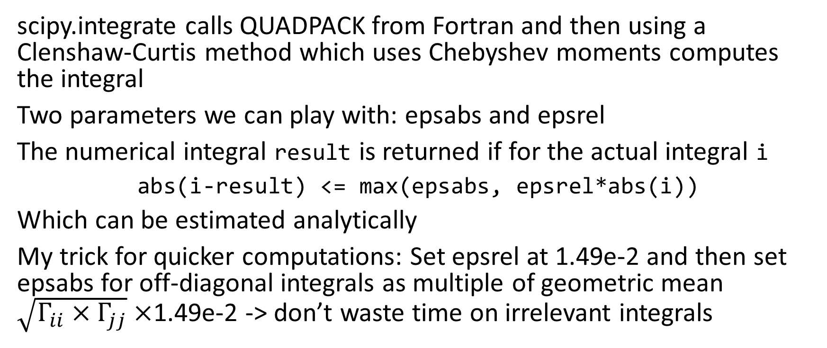
A short recap on numerical integration
scipy.integrate calls QUADPACK from Fortran and then using a Clenshaw-Curtis method which uses Chebyshev moments computes the integral
Two parameters we can play with: epsabs and epsrel
The numerical integral result is returned if for the actual integral i
abs(i-result) <= max(epsabs, epsrel*abs(i))
Which can be estimated analytically
My trick for quicker computations: Set epsrel at 1.49e-2 and then set epsabs for off-diagonal integrals as multiple of geometric mean $\sqrt{Γ_{ii}×Γ_{jj}}×$1.49e-2 -> don’t waste time on irrelevant integrals

Slide 10
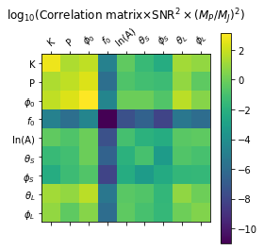

Findings
Looking at the correlation matrix for the 9 parameters of interest:
I again used the same position as Cutler, $f_{0}$ = 10 mHz and P = 2 yr
We can easily discard the $f_{0}$fit, as the determination of the GW frequency isn‘t very problematic

Slide 11
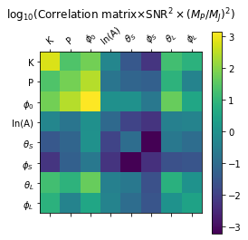
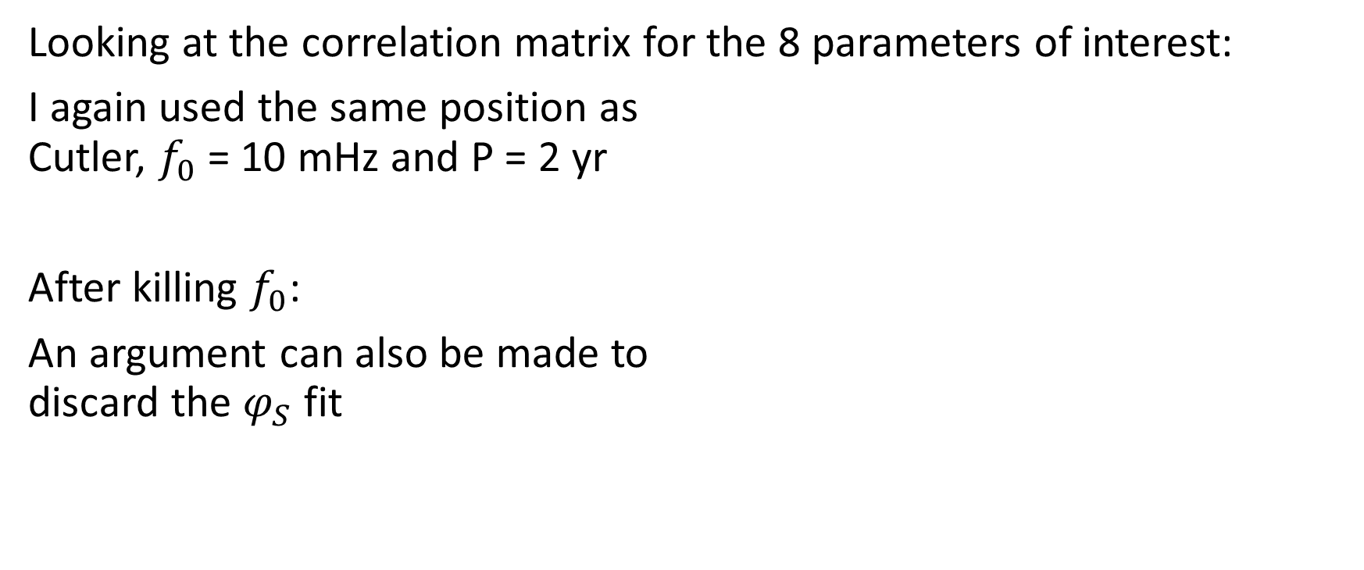
Findings
Looking at the correlation matrix for the 8 parameters of interest:
I again used the same position as Cutler, $f_{0}$ = 10 mHz and P = 2 yr
After killing $f_{0}$:
An argument can also be made to discard the $φ_{S}$ fit

Slide 12
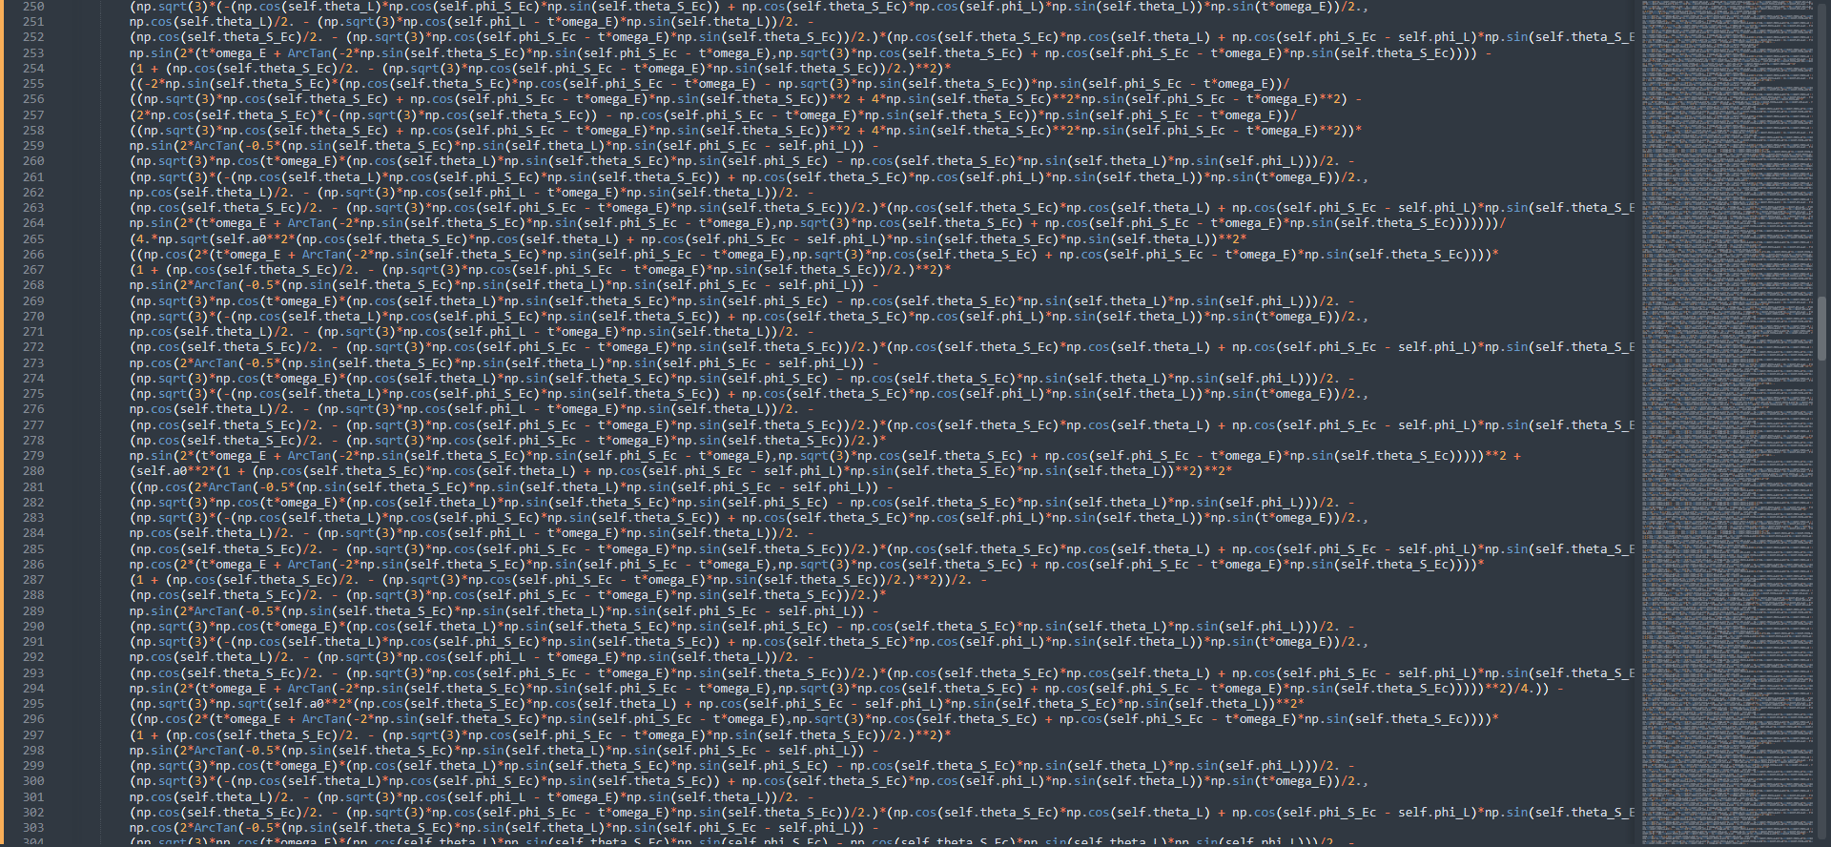
Note that the analytic derivative does exist, but it is a) too long for pretty code – you see a snippet of the 657 lines of terms for $\frac{∂h_{α}}{∂θ_{S}}(t)$ in python code, see delh_delthetaS.txt on Git and…

Slide 13
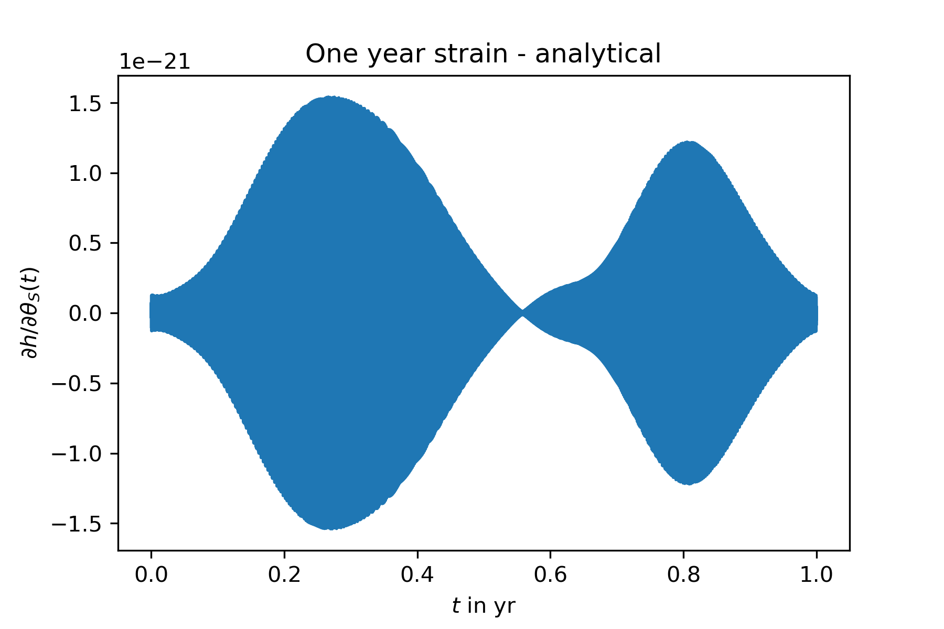
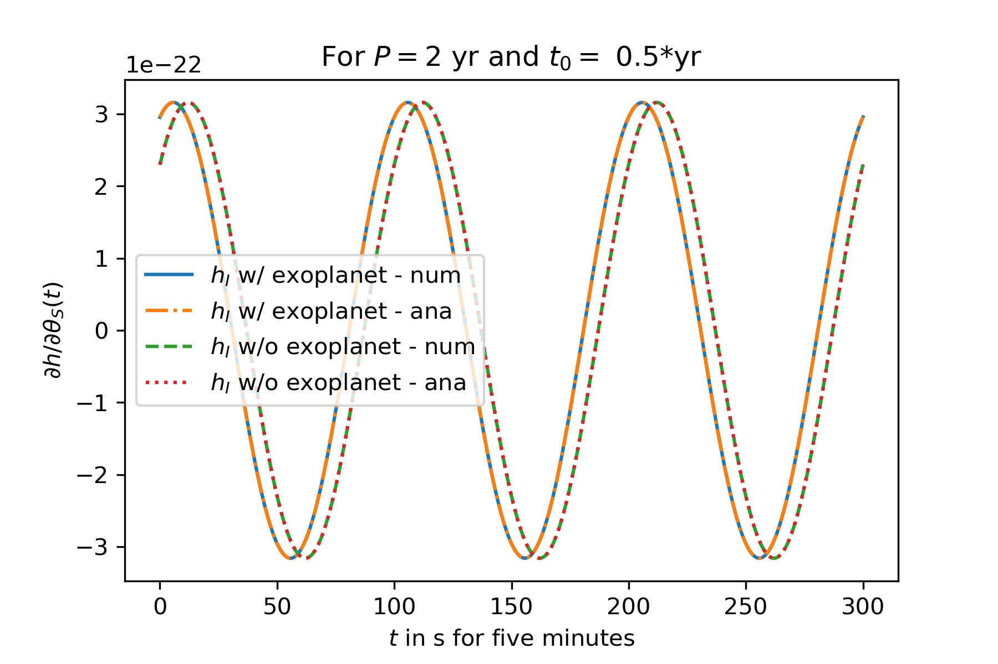
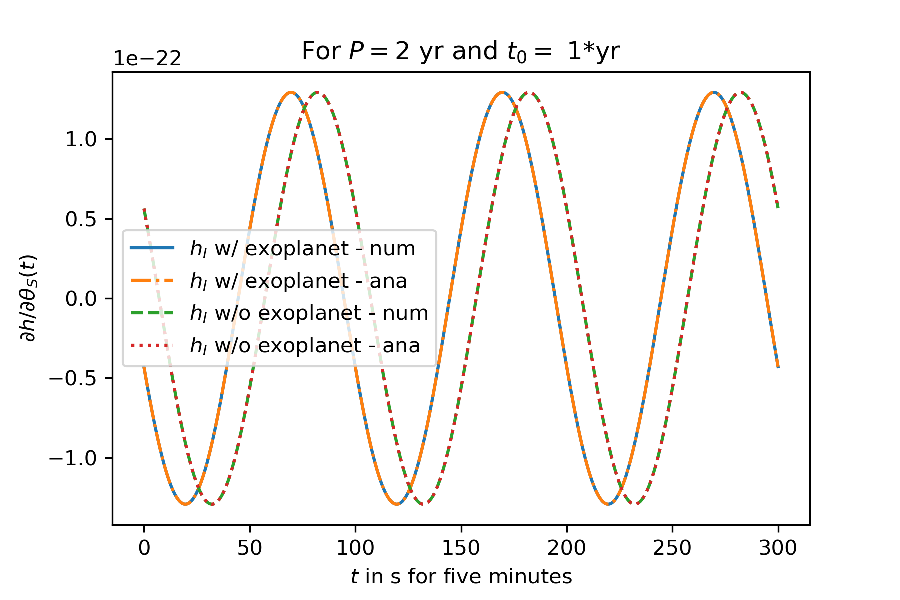
 | Numerical derivative | Analytic derivative
Shape of the Amplitude
Shape of the frequency (1 hour after 0.3*yr)
b) results in the same function anyways, plus…

Slide 14
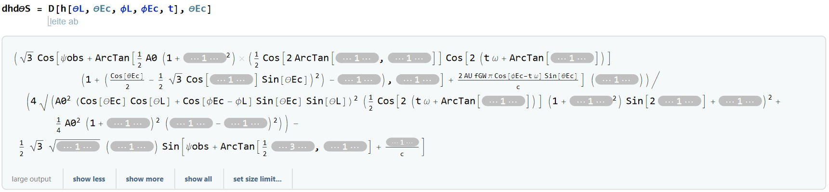
And sadly life would be too easy if we could integrate it analytically :c
c) neither Simplify nor Integrate will return

Slide 15
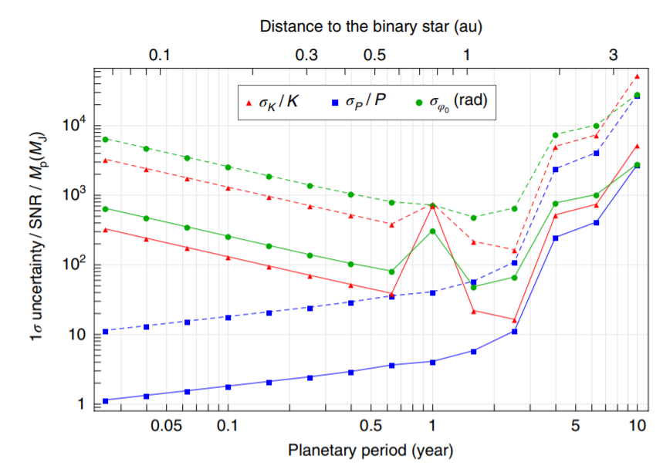
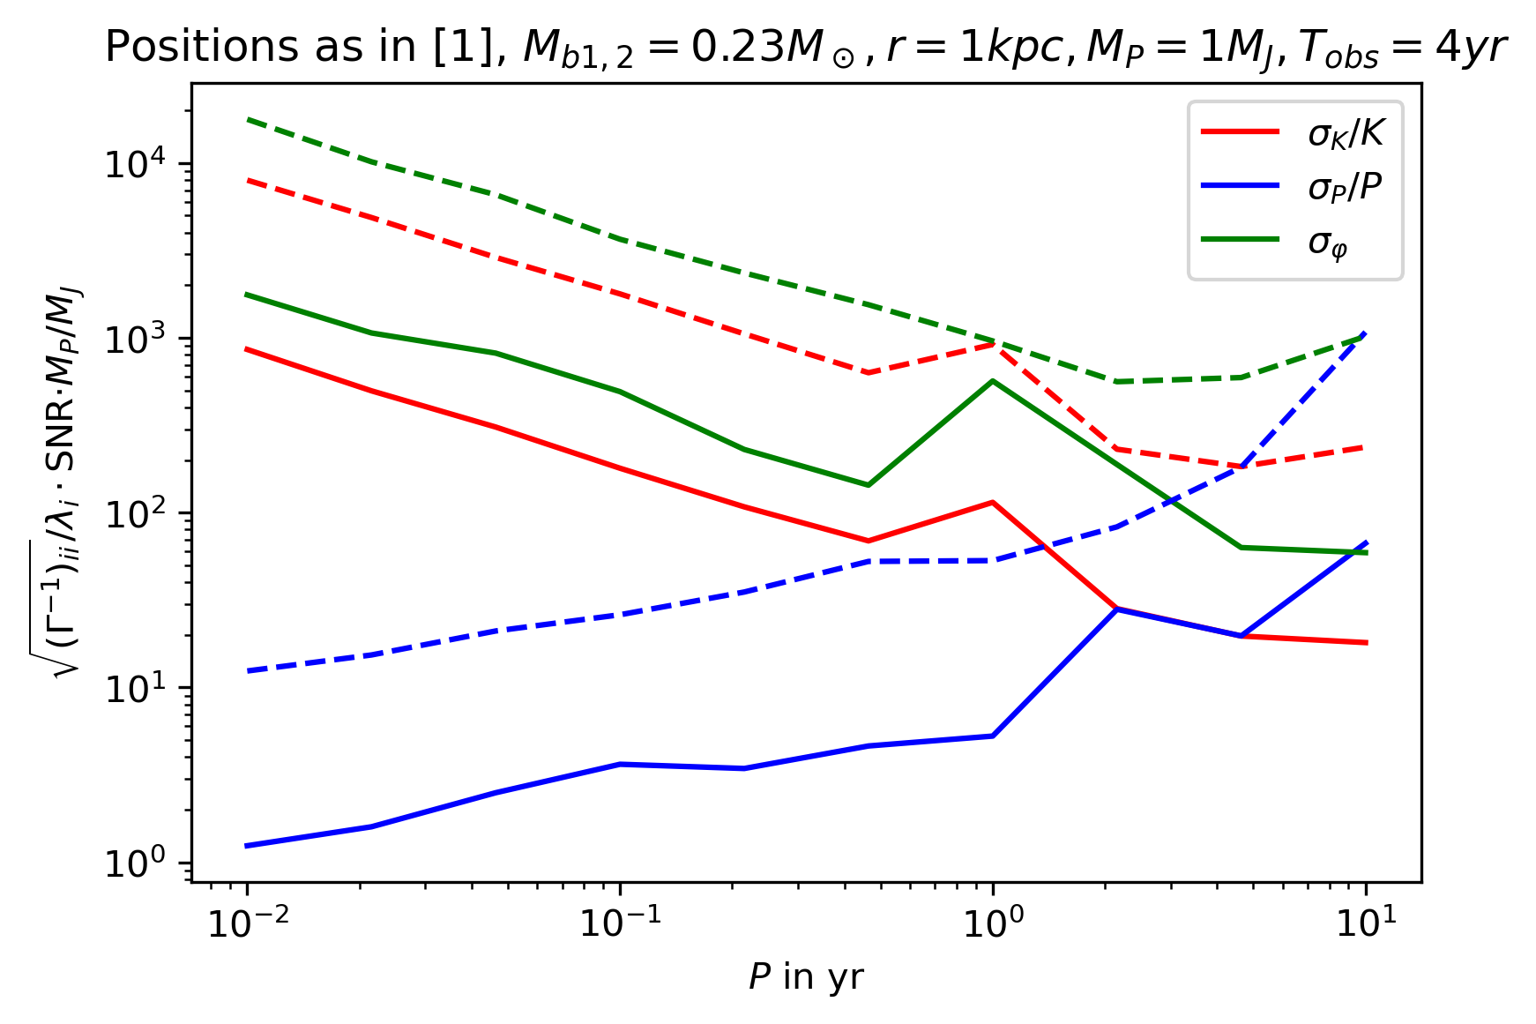
Computing the uncertainties
This plot took ~11 h of computation time: 10 P‘s * 2 frequencies * 28 integrals * 500‘000 oscillations
My guess for the differences: This calculation was without fit for $\ln\left(A\right), f_{1}$

Slide 16
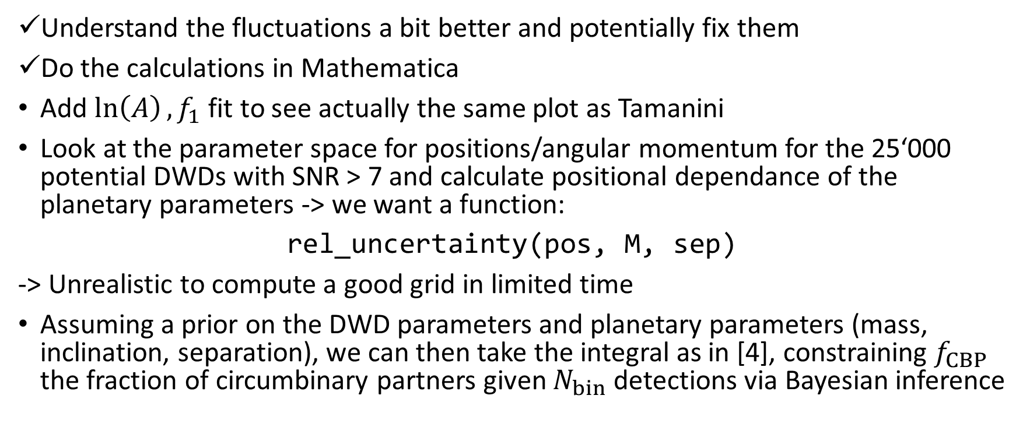
Next milestones
Understand the fluctuations a bit better and potentially fix them
Do the calculations in Mathematica
Add $\ln\left(A\right), f_{1}$ fit to see actually the same plot as Tamanini
Look at the parameter space for positions/angular momentum for the 25‘000 potential DWDs with SNR > 7 and calculate positional dependance of the planetary parameters -> we want a function:
rel_uncertainty(pos, M, sep)
-> Unrealistic to compute a good grid in limited time
Assuming a prior on the DWD parameters and planetary parameters (mass, inclination, separation), we can then take the integral as in [4], constraining $f_{CBP}$ the fraction of circumbinary partners given $N_{bin}$ detections via Bayesian inference

Slide 17
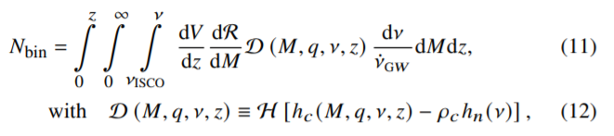
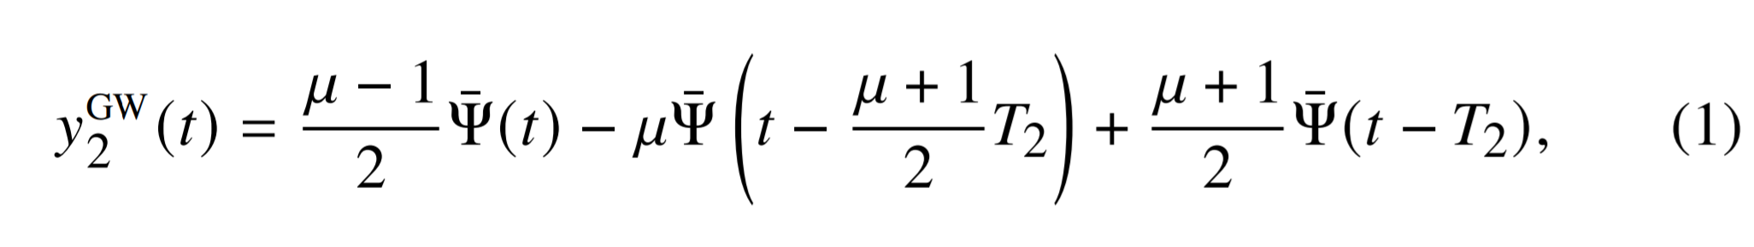
Next milestones
Then repeat the exercise with the strain and signal to noise of the IceGiant mission: to see if it could see most promising exoplanet candidates/Jupiter-like planets
Try to combine measurements of IceGiant and LISA

Slide 18
References
[1] Tamanini, N., Danielski, C. (2019). The gravitational-wave detection of exoplanets orbiting white dwarf binaries using LISA. Nat Astron 3, 858–866. https://doi.org/10.1038/s41550-019-0807-y
[2] Danielski, C., Korol, V., Tamanini, N., & Rossi, E.M. (2019). Circumbinary exoplanets and brown dwarfs with the Laser Interferometer Space Antenna. Astronomy and Astrophysics, 632.
[3] Cutler, C. (1998). Angular resolution of the LISA gravitational wave detector. Physical Review D, 57, 7089-7102.
[4] Soyuer, D., Zwick, L., D’Orazio, D., Saha, P. (2021). Searching for gravitational waves via Doppler tracking by future missions to Uranus and Neptune. MNRAS: Letters, 503, 1, L73-79. https://doi.org/10.1093/mnrasl/slab025
[5] Maggiore, M. (2008). Gravitational Waves Volume 1: Theory and Experiments. Oxford University Press

